Slide 1



Assessing Visualization Reproducibility in HPC
David Koop
Triveni Gurram

Slide 2
Assessing Visualization Reproducibility in HPC
Triveni Gurram
David Koop

Slide 3

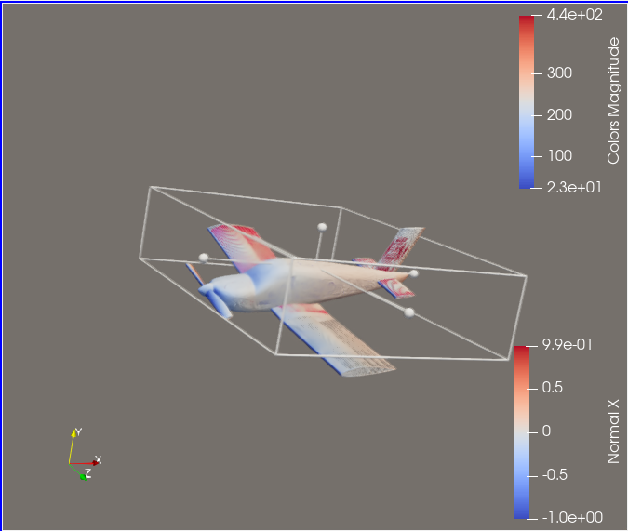
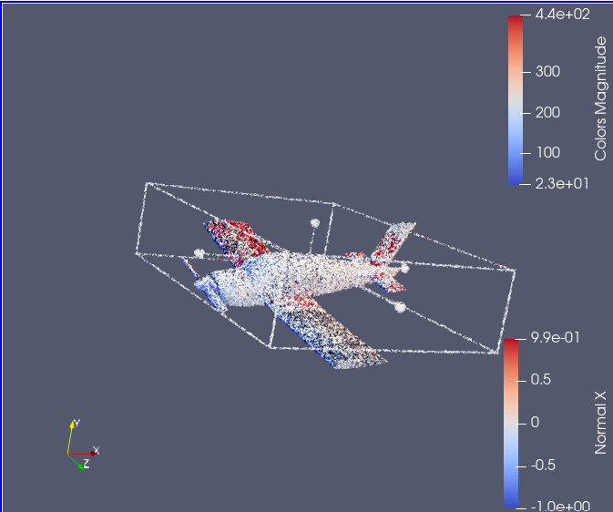
Challenges
Introduction: Reproducibility in Data Visualization
Does the visualization on the right reproduce the visualization on the left??
Challenges

Slide 4

Challenges
Tool Development
Creating robust methods for automated comparison.
Significance Determination
Distinguishing between meaningful and trivial visual changes.
Minor Visual Change
Subtle differences can impact reproducibility assessment.
Agenda

Slide 5
HPC and Real-Time Visualization
HPC & Visualization Research
ParaView & In Situ
Visualization Comparison Methods
Reproducibility Approaches
Advantages & Limitations
Lessons & Findings
Conclusion & Future Directions
Agenda

Slide 6

HPC and Real-Time Visualization
Insights into Results
Data visualization is a key tool for gaining insights into results from High-Performance Computing (HPC), including both final and intermediate outcomes.
Visualization Tools
ParaView and VisIt enable researchers to visualize and analyze complex datasets in real time, providing a deeper understanding of computational processes and results.
Challenges with
post-processing
Generated visualizations from simulations often incur prohibitive storage costs, especially when handling large-scale datasets.

Slide 7
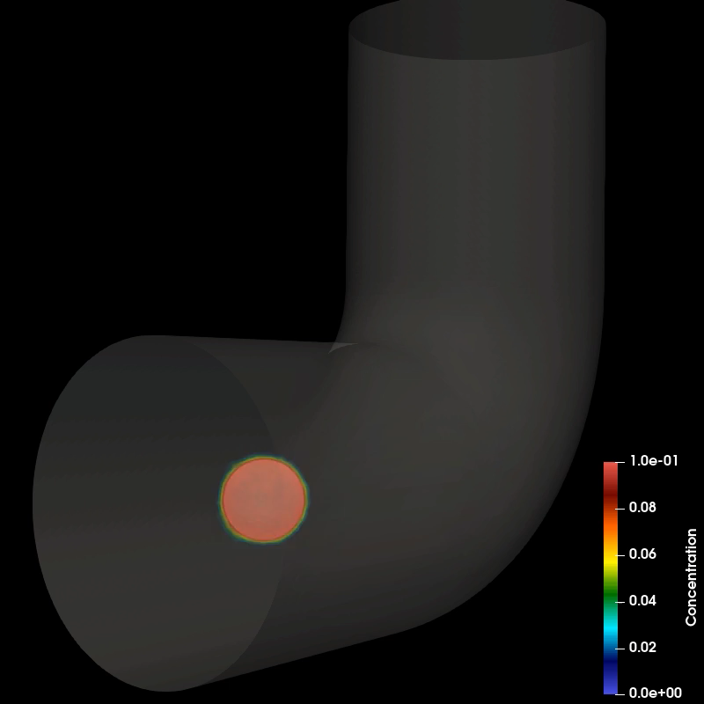
HPC and Real-Time Visualization
Visualization Tools
In Situ Visualization
The In Situ Visualization method was developed to address the storage challenges of post-processing by allowing visuals to be computed on the fly during the simulation process, reducing storage overhead.
Tool | Application | Advantage
ParaView | Large-scale simulations | Distributed rendering
VisIt | Scientific visualization | Scalable architecture
In Situ Methods | Real-time monitoring | Reduced data movement

Slide 8
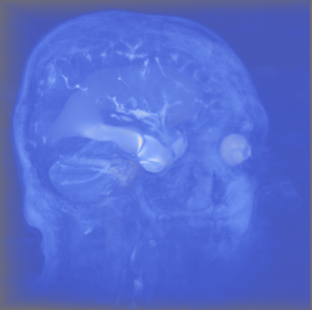

Comparison Tools & Techniques
HPC and Real-Time Visualization
Visualization Tools
Tool/Method | Application | Advantage
ParaView | Large-scale simulations | Distributed rendering
VisIt | Scientific visualization | Scalable architecture
In Situ Methods | Real-time monitoring | Reduced data movement

Slide 9
Pixel Comparison
Comparison Tools & Techniques
Visualization Tools
Pixel comparison
Deep learning models
Image processing is essential
for basic visual comparisons.
Deep learning models can
assist in feature extraction.
Classic vision
techniques
Specialized tools for
charts
Object detection can be
used in scientific visualizations.
Specialized tools can be
used for chart analysis.

Slide 10
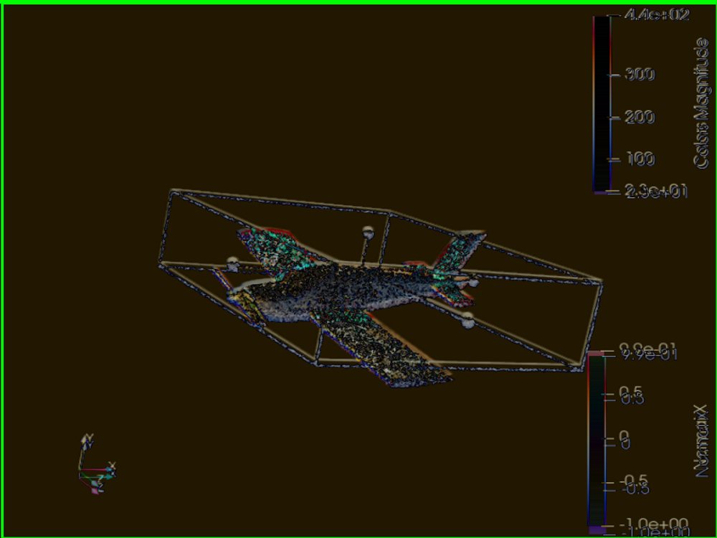
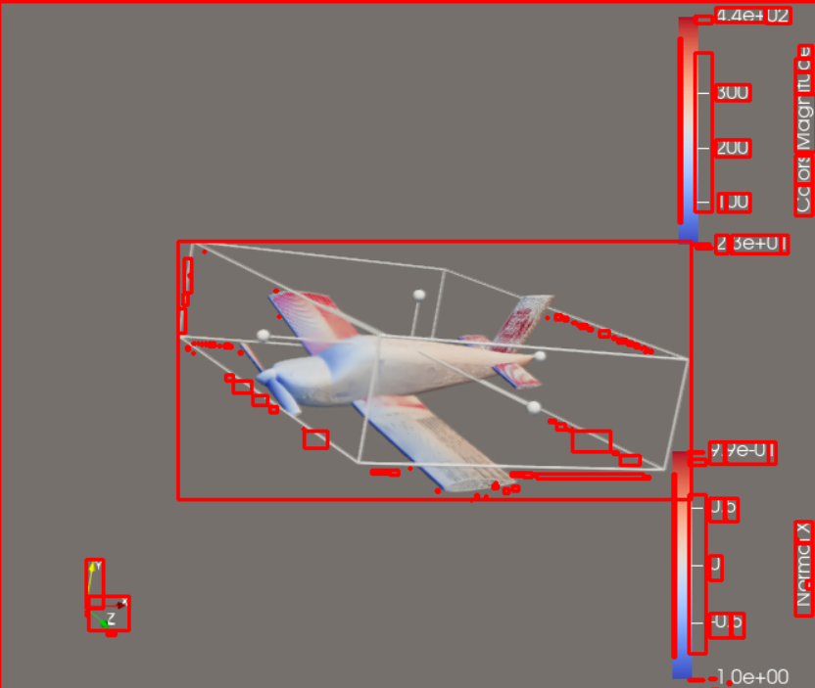
Embedded Metadata Approach
Pixel Comparison
Comparison Tools & Techniques
OpenCV is used for comparing pixel differences between images.
Pros: It can highlight differences between two visualizations effectively.
Cons: Sometimes, pixel-based comparisons might highlight unnecessary regions or subtle visual changes which could lead to misleading results.

Slide 11
Embedded Metadata Approach
Pixel Comparison
Advantages
Improved Transparency
Metadata in images provides a clear, accessible record of how visualizations are created, enhancing transparency.
Enhanced Verification and Comparison
Enables users to verify visualization accuracy and compare similar visualizations using identical or similar parameters
Increased Reproducibility and Reliability
Embedded metadata supports reproducibility and reliability by providing necessary details for recreation directly in the file.
Objective:
Enhance reproducibility by embedding image metadata directly into image files.
Metadata for Reproducibility: By embedding metadata within the image file itself, anyone who accesses the file can retrieve crucial details necessary for recreating the visualization accurately.
Data sources
Include information about data’s origin, including links or identifiers if publicly available.
Visualization parameters
Specify Settings like color schemes, axis ranges, labels, and legends.
Scale and precision
Provide details about scales, units of measure, and rounding or aggregation methods.
Limitations
Metadata Standardization
Standardizing metadata fields ensures critical information is consistently recorded and accessible.
File Size and Compatibility
Metadata can slightly increase file size and may be removed by some tools, so compatibility must be considered.
Work contributed by Arya Sarkar

Slide 12
Embedded Metadata Approach
Histogram Comparison
Advantages
Improved Transparency
Metadata in images provides a clear, accessible record of how visualizations are created, enhancing transparency.
Enhanced Verification and Comparison
It Enables users to verify visualization accuracy and compare similar visualizations using identical or similar parameters.
Increased Reproducibility and Reliability
Embedded metadata supports reproducibility and reliability by providing necessary details for recreation directly in the file.
Limitations
Metadata Standardization
Standardizing metadata fields ensures critical information is consistently recorded and accessible.
File Size and Compatibility
Metadata can slightly increase file size and may be removed by some tools, so compatibility must be considered.
Work contributed by Arya Sarkar

Slide 13
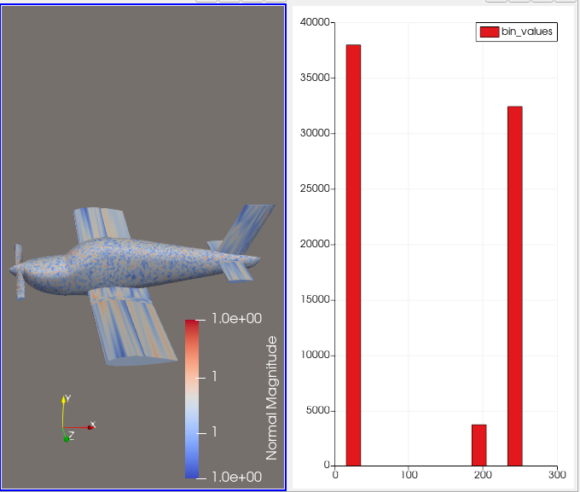
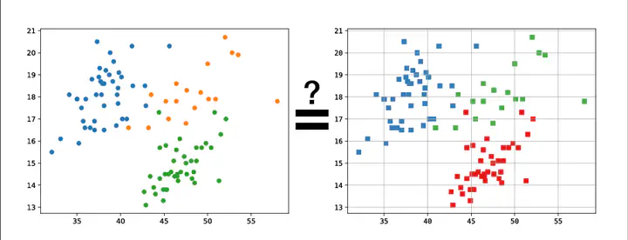
Data Extraction & Highlighting Approach
Embedded Metadata Approach
Histogram Comparison
Utilizing Histogram Data:
Aggregate Visualizations in Research
In large-scale calculations, research often uses
aggregate visualizations, like histograms, to summarize and characterize the data rather than providing full visualizations.
Recreating and Comparing Visualizations
We can use the provided code to generate the same visualizations. However, it's crucial to compare these recreated visuals to assess reproducibility.

Slide 14
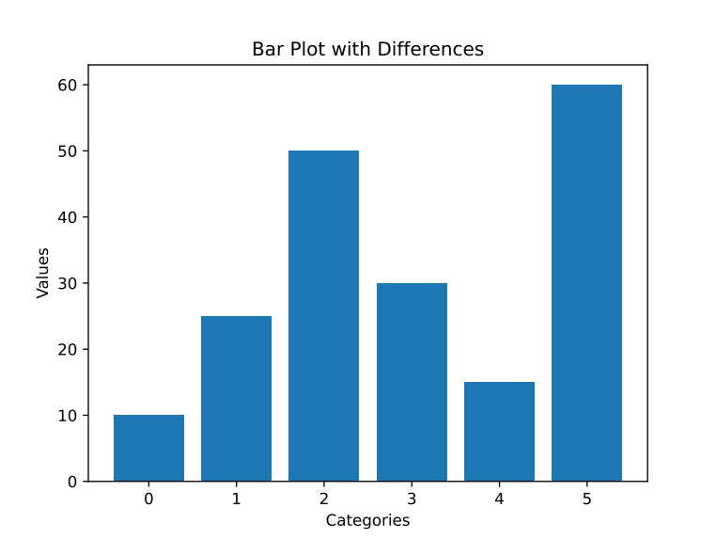
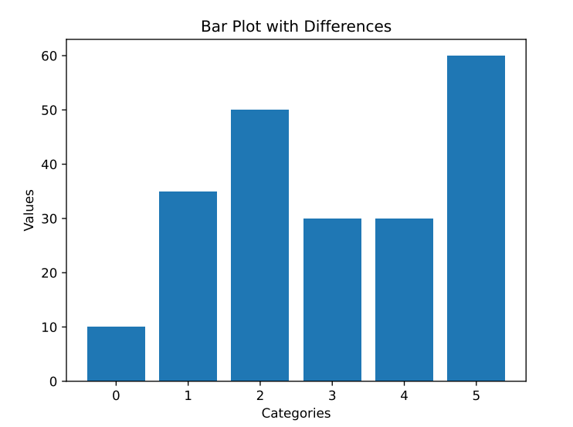
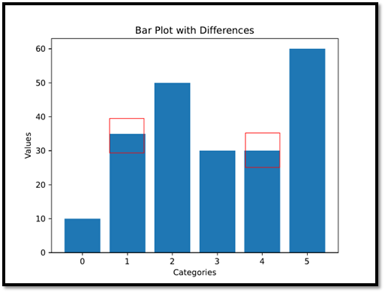
Data Extraction & Highlighting Approach
Advantages:
Supports Reproducibility: Enables users to identify meaningful differences, helping determine if visualizations are accurately reproduced.
Semantic Comparison: Focuses on core data and structure, filtering out superficial differences like font or style changes.
Modified the Chart Detective tool to enhance
visualization comparison.
Key Steps:
Data Extraction with Chart Detective
Extract data values and pixel coordinates,
then save this information in a CSV file.
Input to Comparison Script
Use extracted CSV files along with input images for visualization comparison.
Difference Calculation and Highlighting
Compare data values from the CSV files. Differences exceeding a predefined threshold are marked as significant and highlighted for easy identification.
Limitations:
Specialized Tools Required: Different visualization types require specific tools or adaptations, making it challenging to handle diverse or non-standard visualizations.
Complex Layouts: Non-standard or complex visualizations, especially those with embedded text or low resolution, can be difficult to process and may require additional manual adjustments for accuracy.
Limitations:
Specialized Tools Required: Different visualization types (e.g., bar charts, scatter plots) require specific tools or adaptations, making it challenging to handle diverse or non-standard visualizations.
Complex Layouts: Non-standard or complex visualizations, especially those with embedded text or low resolution, can be difficult to process and may require additional manual adjustments for accuracy.

Slide 15
Lessons & Findings
Data Extraction & Highlighting Approach
Advantages:
Supports Reproducibility: It enables users to identify meaningful differences, helping determine if visualizations are accurately reproduced.
Semantic Comparison: It focuses on core data and structure, filtering out superficial differences like font or style changes.
Limitations:
Specialized Tools Required: Different visualization types require specific tools or adaptations, making it challenging to handle diverse or non-standard visualizations.
Complex Layouts: Non-standard or complex visualizations, especially those with embedded text or low resolution, can be difficult to process and may require additional manual adjustments for accuracy.

Slide 16
Conclusion
Lessons & Findings
Critical vs. Trivial
It is important of distinguish significant visual differences.
Tolerance Levels
Acceptable thresholds for visual
differences should be established.
System Variations
Minor differences often arise from software
or hardware variations.

Slide 17
Future Direction
Conclusion
Lessons & Findings
Reproducibility in HPC
Ensures consistent and reliable visualizations across different systems and times is essential for validating research and enabling future comparisons.
Key Approaches to Enhance Reproducibility of Visualizations
Metadata Integration
Histogram and Data Comparisons
Automated Comparison

Slide 18
Future Direction
Conclusion
Nuanced reproducibility checks
Develop methods to distinguish between critical variations and minor discrepancies.
Expand approach
Improve handling of diverse visualizations and categorize differences for better reproducibility assessments.
Integration with HPC tools
Investigate adding reproducibility checks to tools like ParaView and VisIt, leveraging HPC for large-scale simulations and clearer, more reliable results.

Slide 19
Thank you!
Do you have any questions?

